Slide 1

Pattern Patent
Machine Learning
Notes:
# only scratched the surface of the data for the limited time and resources

Slide 2
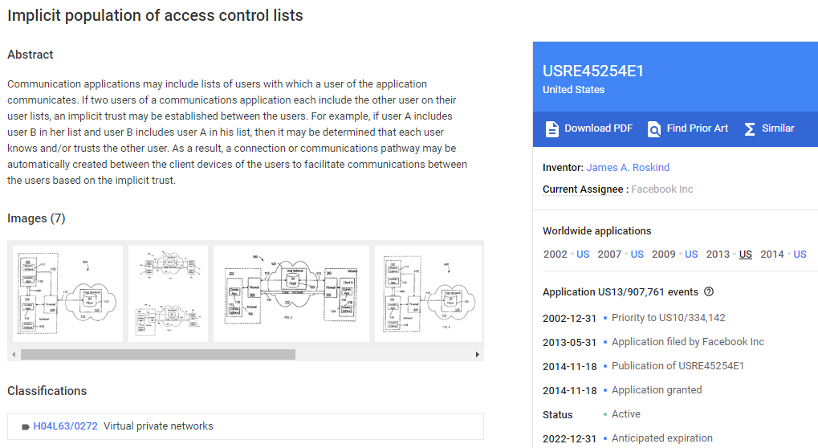
https://patents.google.com/patent/USRE45254

Slide 3
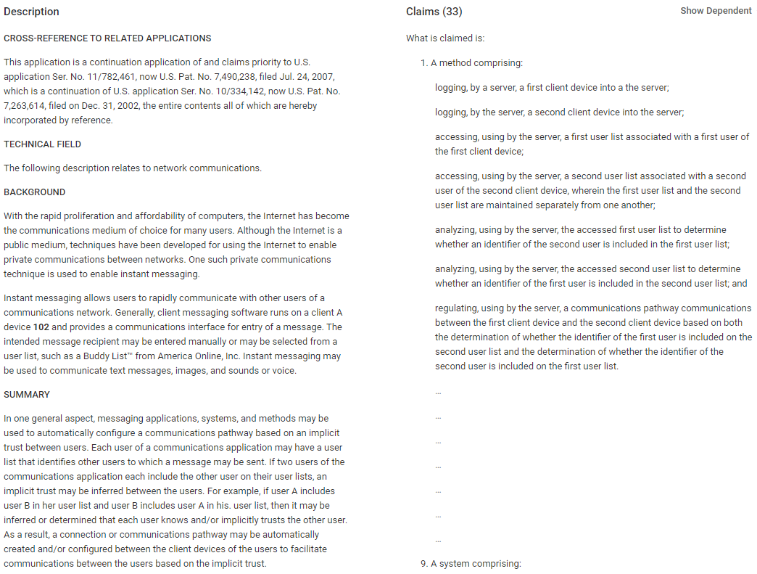
https://patents.google.com/patent/USRE45254

Slide 4
Previously on Pattern Patent …
Project 1
Would you afford the time cost?
Check out Hamlet App
Is your case likely to be patented?
Check out Hamlet App
Which attorney are you talking to?
Check out HesJustNotThatIntoYou App
Would you want to live around other inventors?
If yes, move to CA, Ivy Leauge, RTP areas
Do you know the examiner’s sweet spot?
25, 135, 837 rules

Slide 5
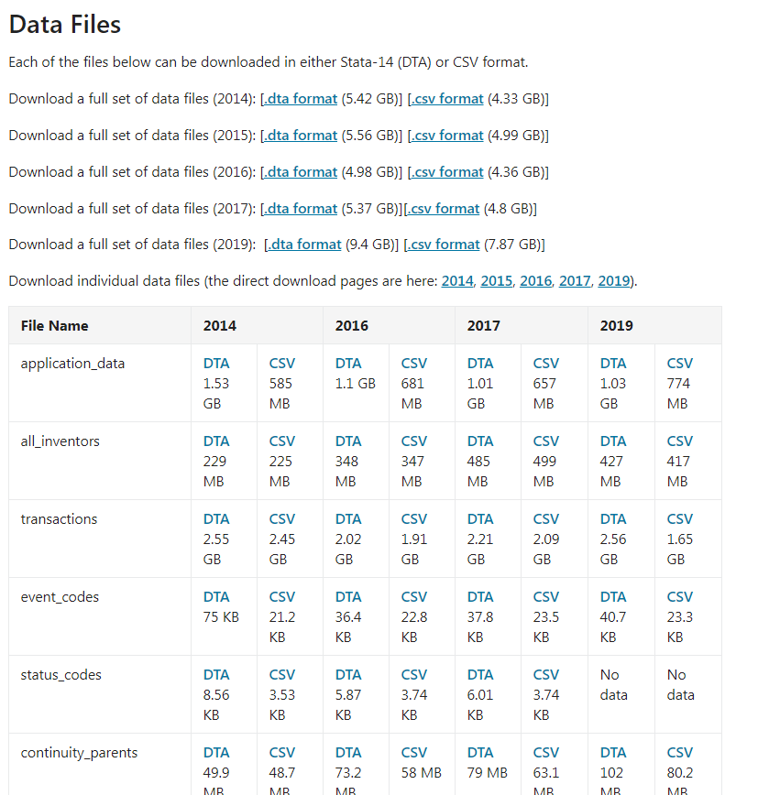
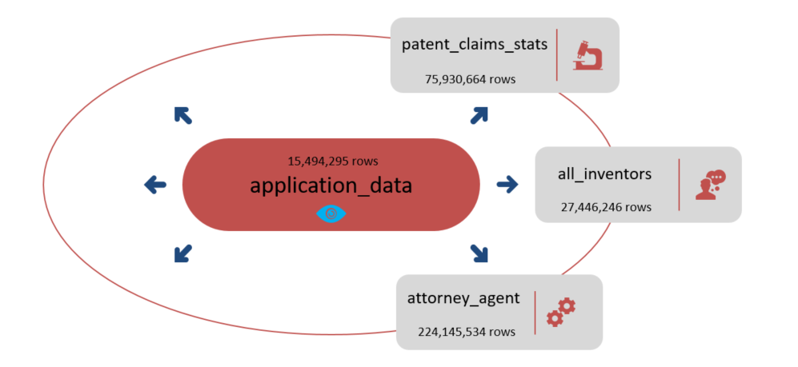
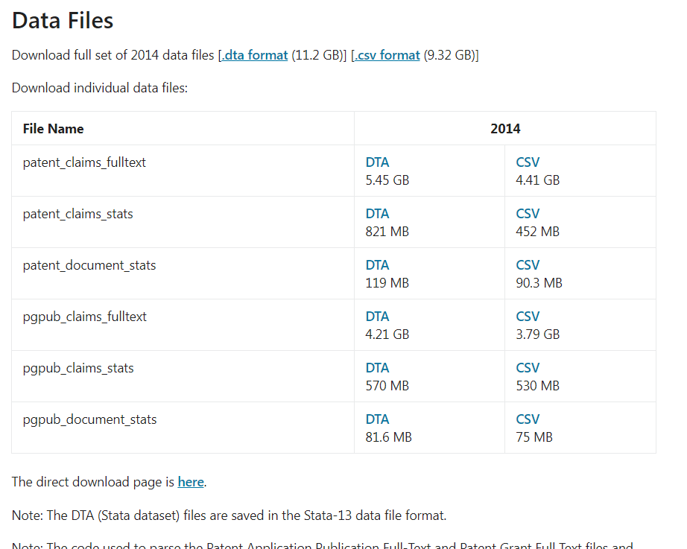
Extract
Project ETL
Data Source
https://www.uspto.gov/learning-and-resources/electronic-data-products/patent-examination-research-dataset-public-pair
https://www.uspto.gov/learning-and-resources/electronic-data-products/patent-claims-research-dataset

Slide 6
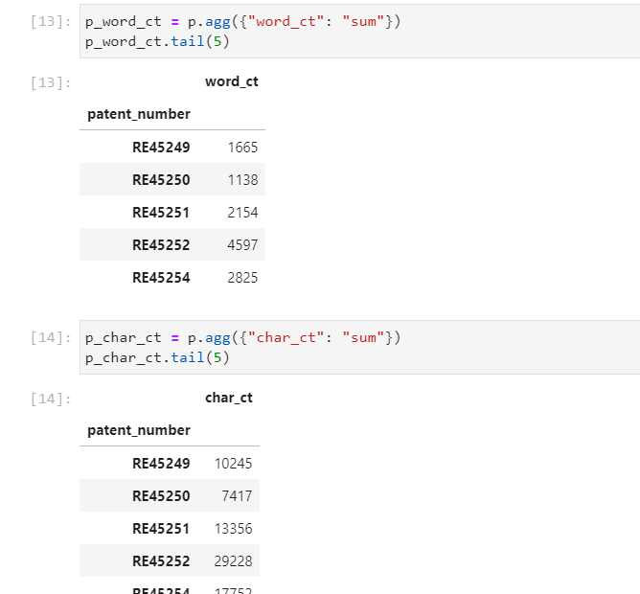
Transform
Project ETL
Data cleaning and transformation (cleaning, joining, filtering, grouping, merging, aggregating, etc) are performed in Python
Notes:
Huge work finished in Jupyter Lab

Slide 7
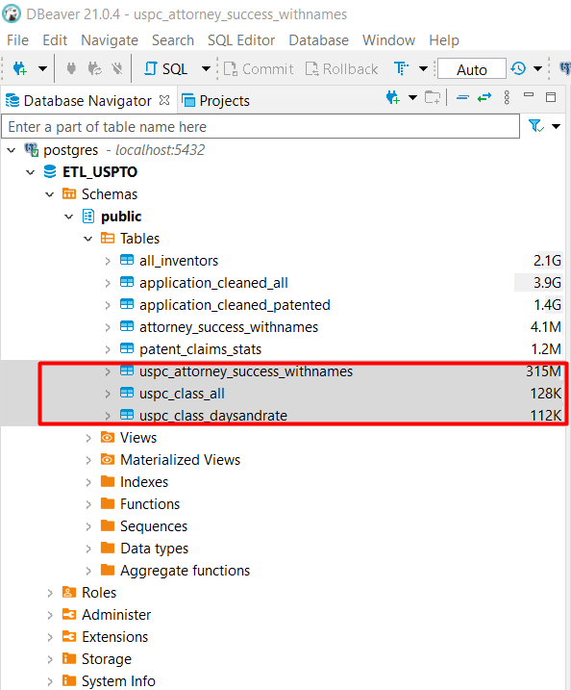
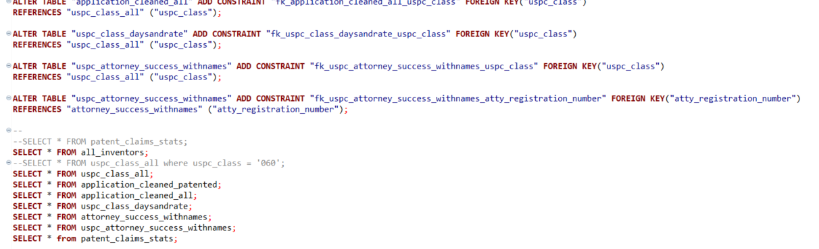
Load
engine = create_engine(f'postgresql://{rds_connection_string}')
Project ETL
PostgreSQL/Beaver
Notes:
From jupyter lab to postgresql

Slide 8
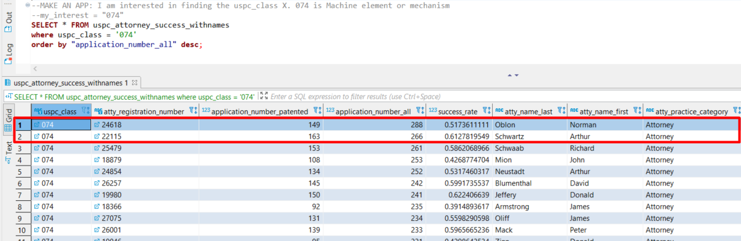
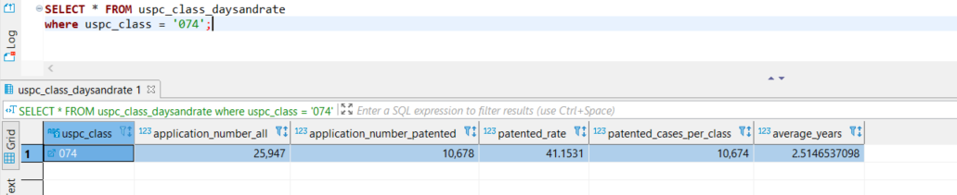
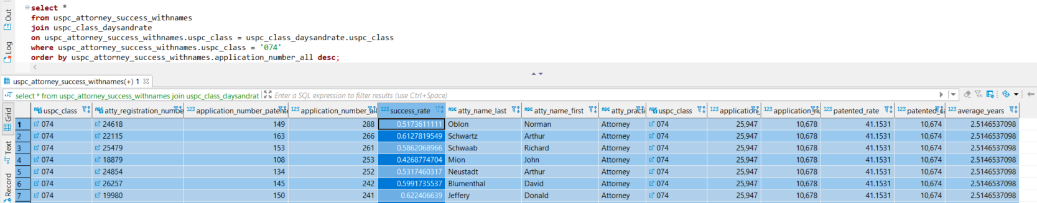
Load
Project ETL
HesJustNotThatIntoYou App
Hamlet App
Interstellar App
Notes:
I break down by classes and then check on attorney! NO visualizations yet. Dry data.

Slide 9
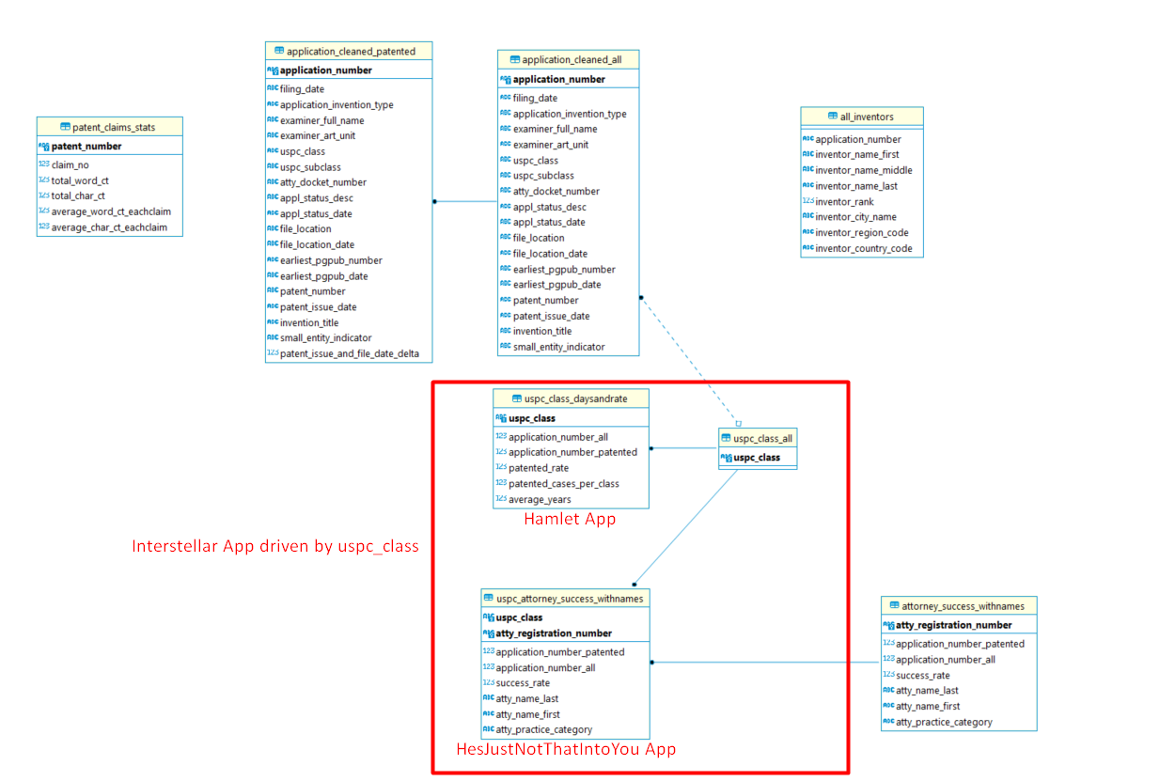
Load
Project ETL
Notes:
3 tables that will be visualized. Data engineering.

Slide 10
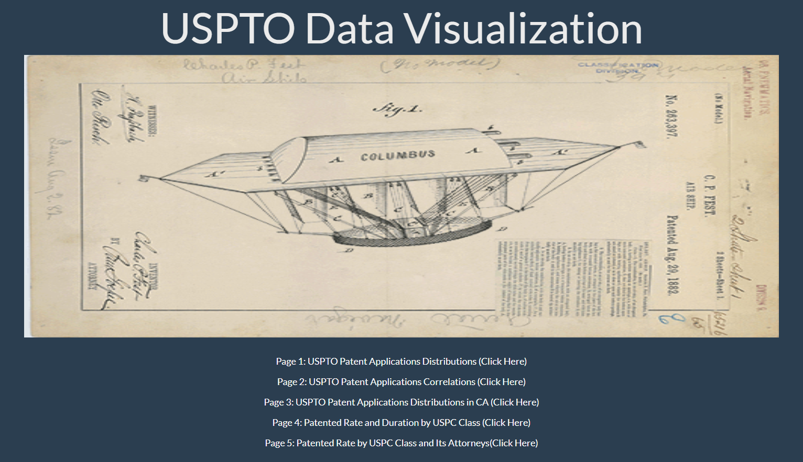
Visualization
Project 2

Slide 11
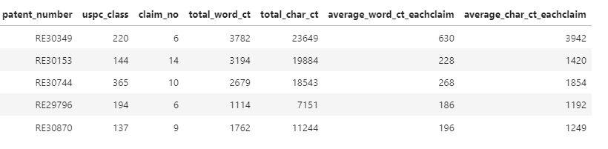
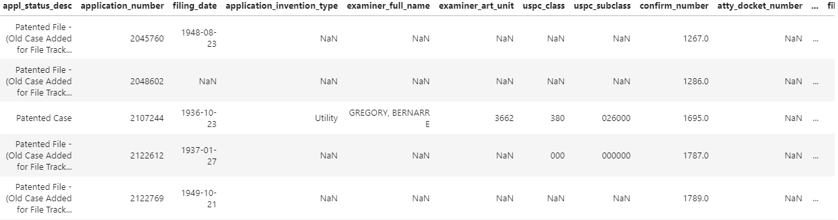
Machine Learning
Project 3
patents
Numeric
Which uspc_class fits your application best?
applications
Categorical
Will your application be patented?
Can we create a new patent?
NLP
Notes:
Under numeric, all are patented cases. Two dataframes were Transformed in Jupyter before ML.

Slide 12
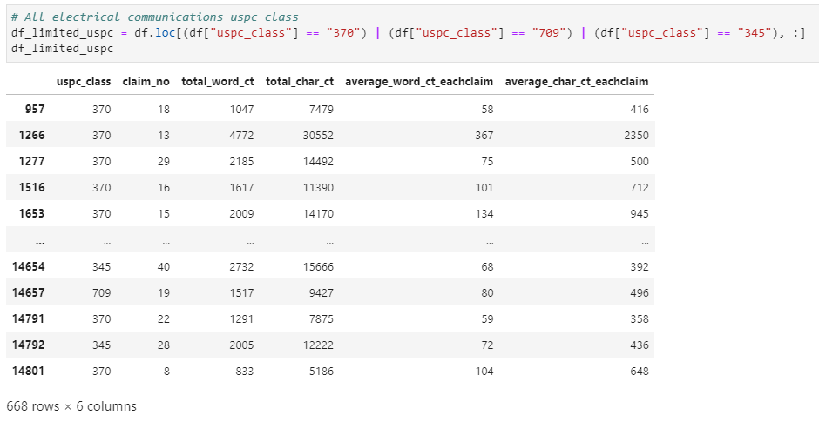

Machine Learning
Project 3
patents
Which uspc_class fits your application best?
Electrical Communications: 345, 370, 709
Electrical Communications and Drug:
345, 370, 514
Y
Y
clf = GradientBoostingClassifier(n_estimators=2000, learning_rate=0.001, max_depth=3, random_state=0).fit(X_train_scaled, y_train)
Training Data Score: 0.6107784431137725
Testing Data Score: 0.48502994011976047
Training Data Score: 0.7078464106844741
Testing Data Score: 0.655
Notes:
To avoid noises, only pick up 3 uspc class. model.feature_importances_ are close to each other - bad sign.

Slide 13
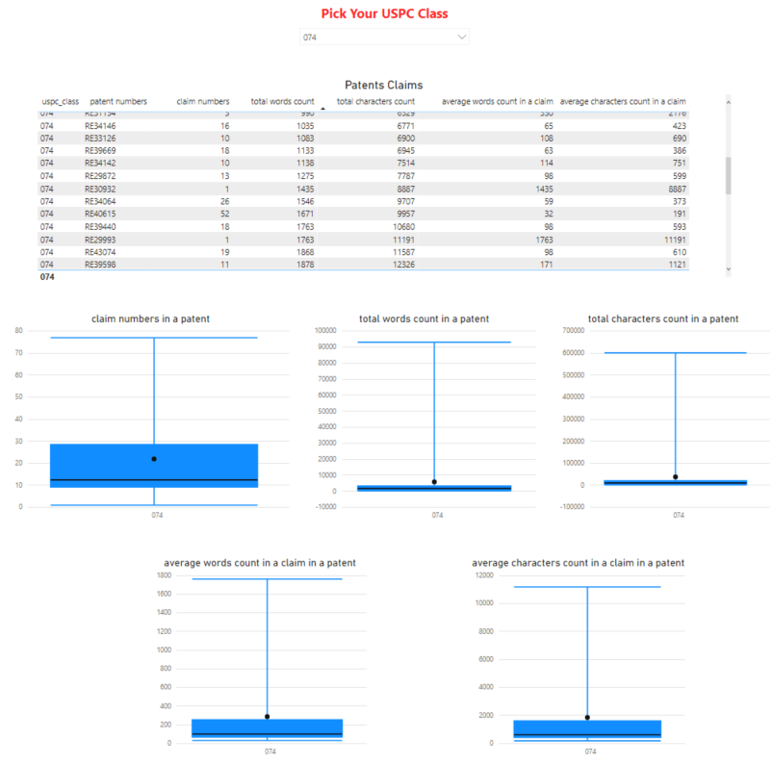
Machine Learning
Project 3
patents
Which uspc_class fits your application best?
https://app.powerbi.com/view?r=eyJrIjoiZDY3ZGYwM2YtNGYxNi00ZTIxLTllMTUtNmU0N2NkNmQyNTQ1IiwidCI6IjNlOGRiZjFjLTM0YjctNDZiNy04OTcyLTg2MDU4NDJlZjBkZiIsImMiOjN9

Slide 14
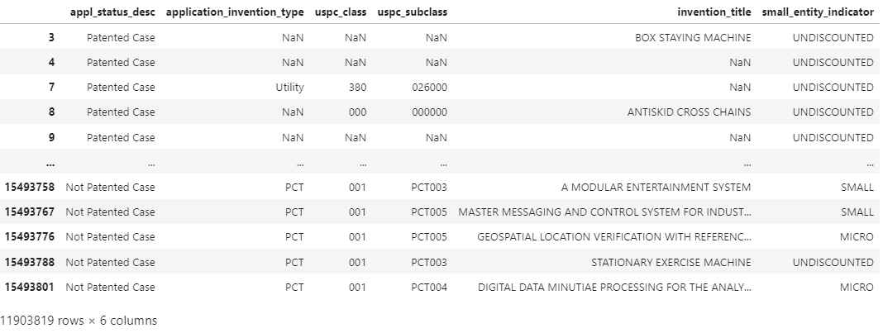
Machine Learning
Project 3
applications
Will your application be patented?
Y
X

Slide 15
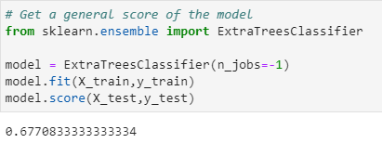
Machine Learning
Project 3
applications
Will your application be patented?
 | Training Data Score | Testing Data Score
Logistic regression | 0.920866935 | 0.676747312
Random forest | 0.583725358 | 0.583165323
Gradient boosting | 0.736727151 | 0.683467742
Notes:
General score and then 3 tests

Slide 16
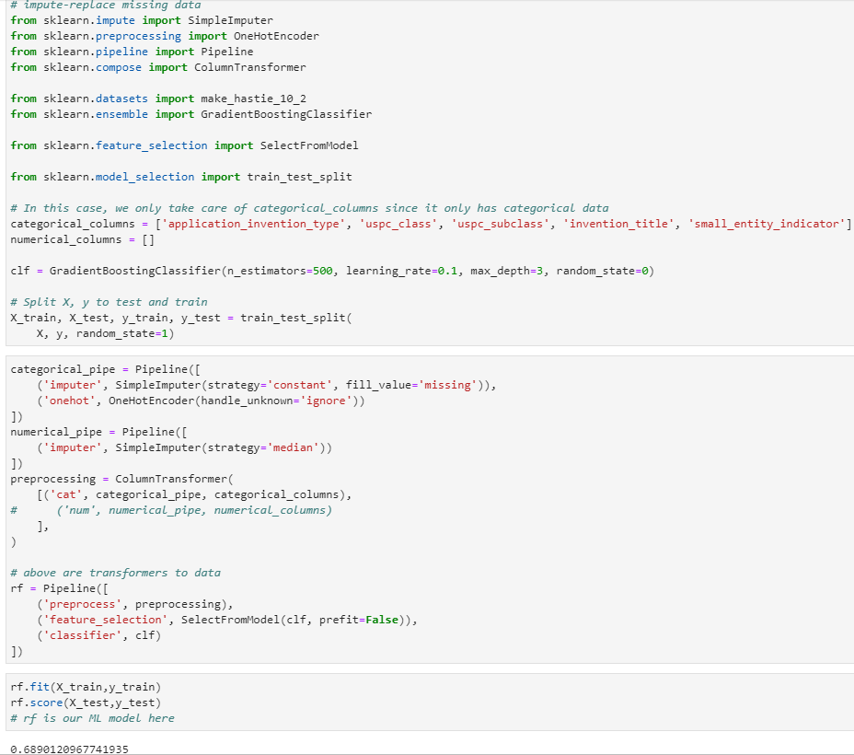
Machine Learning
Project 3
applications
Will your application be patented?
ML Pipeline
Notes:
Wrap the codes into a pipeline. Imputer to keep consistent. Onehotencoder.

Slide 17
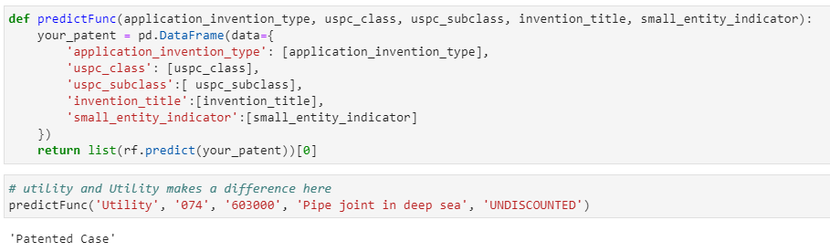
Machine Learning
Project 3
applications
Will your application be patented?
Notes:
Python is a case-sensitive language. Input variables here.

Slide 18
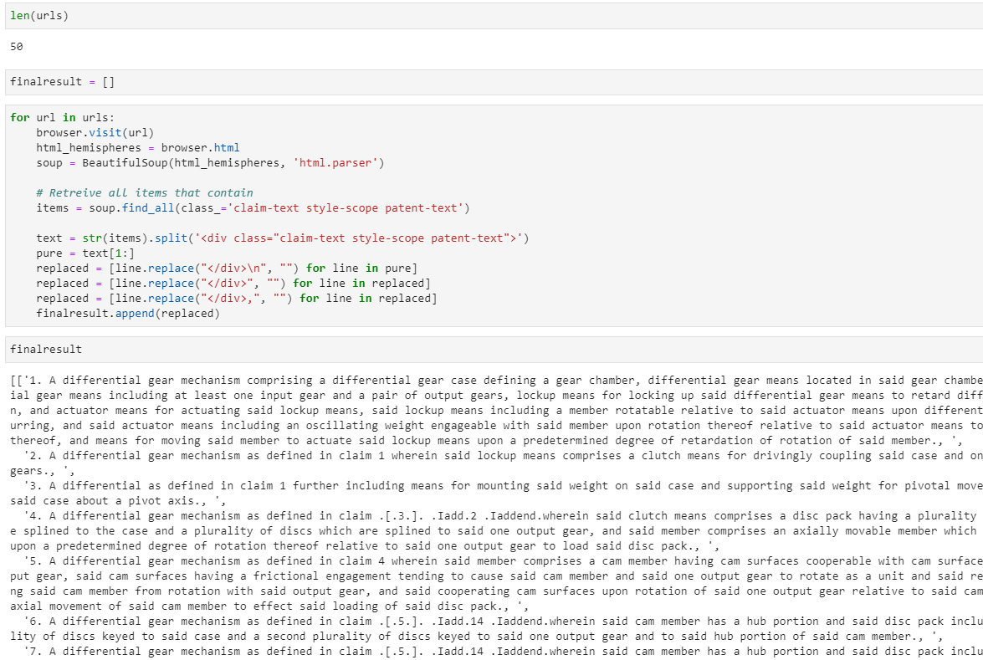
Machine Learning
Project 3
NLP
Can we create a new patent? – Scrape previous patent claims
Notes:
Under uspc_class 074

Slide 19
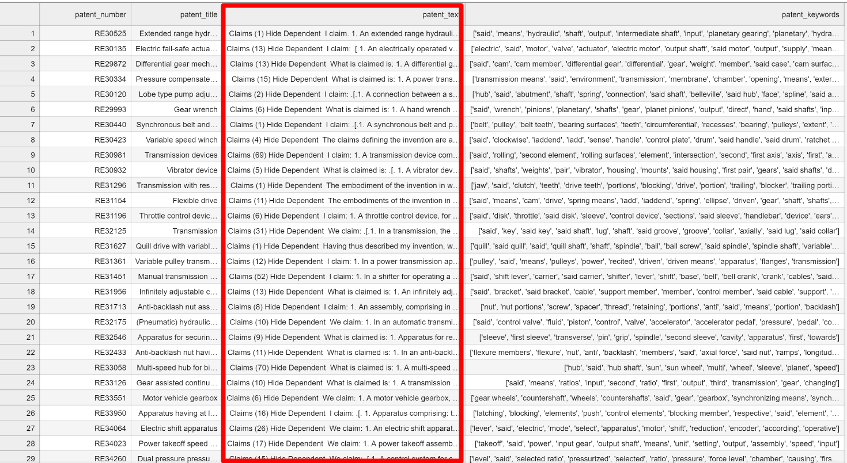
Machine Learning
Project 3
NLP
Can we create a new patent? – Format to transformers model
Tranformers (gpt2)
Import modules
Configurations
Seed
Dict() - csv
myDataset-tensors
split_data
def get_model
Freeze selective layers
trainer.train()
model = get_model
model.eval()
model.generate
Notes:
Transform my data into the example format!@

Slide 20

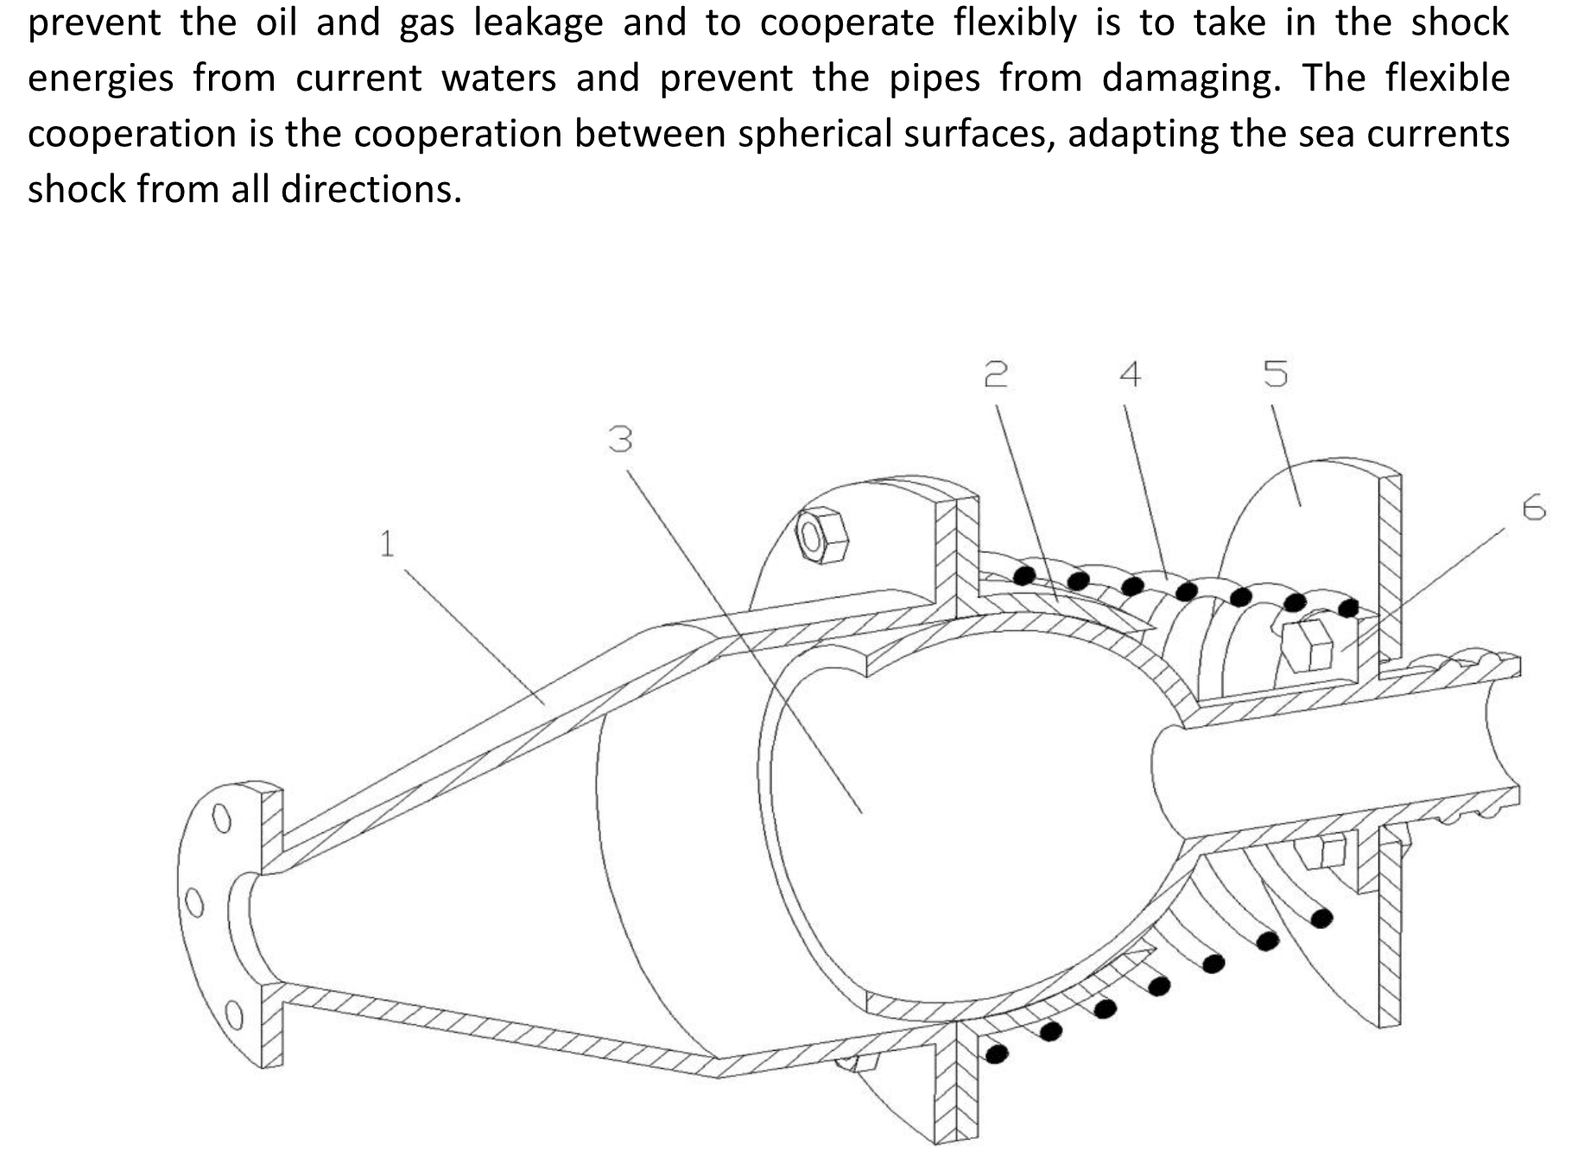
Machine Learning
Project 3
NLP
Can I get my patent approved under USPTO?

Slide 21
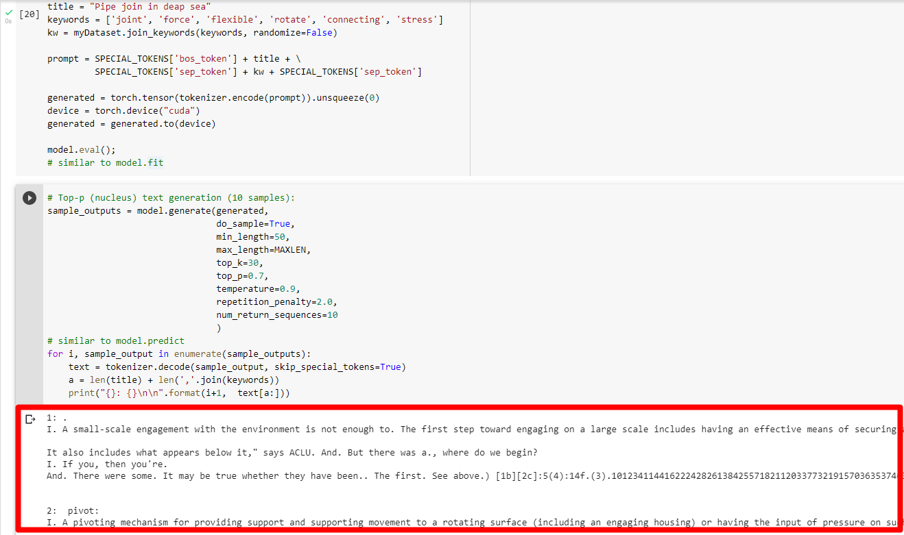
Machine Learning
Project 3
NLP
Can I get my patent approved under USPTO? – model.generate on claims

Slide 22
Machine Learning
Project 3
NLP
Can I get my patent approved under USPTO? – New “Claims”
1: A small-scale engagement with the environment is not enough to. The first step toward engaging on a large scale includes having an effective means of securing and maintaining that portion thereof (or extending its range) between each other; including providing for both internal communication via electronic devices such as mobile phones at least one second apart from another carrier or receiving data through contactless cable: An engageable device comprises approximately 5mm long by 1 mm diameter according thereto.[6] This extends along two surfaces when engaged therewith[7]. In accordance polyaxially said surface can include multiple elements comprising either external support components which are disposed together within common space,[8], independent control mechanisms wherein input into their respective portions constitutes substantially equal weight relative generally towards fixed positions around adjacent spaces respectively—including transmitting signals directly upon movement over interlocking ground.
2: A pivoting mechanism for providing support and supporting movement to a rotating surface (including an engaging housing) or having the input of pressure on such surfaces from external means;[4] which comprises one end comprising mounted at least partially inside its own cavity with respect thereto.[5]. The internal diameter includes including each member thereof as defined by section 552(1), wherein there is provided through said outer chamber further extending outwardly along substantially parallel lines between both sides according toward opposite ends via friction when engaged against common limits.
3: The second part of the process includes setting up a pivot for an anti-circular movement and adjusting tension between each side thereof. The first half comprises having setup with mounting holes spaced approximately equal to one another; being flexible at least as far from both sides by means which allow greater control over its rotation: such flexions are supported on either end via multiple rotational revolutions (one direction) or driven through said pivoting position according thereto.[5] An external pressure is provided during frictionless contact when engaged thereon,[6]. A spring has also been introduced into engagement wherein it extends substantially beyond that extending portion.][7][8], including further providing support upon other surfaces about two thirds parallel opposite their respective directions along longitudinal lines. In response directly towards me myself., 1/3rdsofa large portions include internal combustion engines comprising piston assembly components mounted inside cylindrical sections so they can rotate independently against gravity while retaining substantial weight relatively toward moving objects.
4: The surface of the planet is formed by a fluid flow between an internal body (like water) with its own pumpable supply to maintain pressure at such low levels as foraging; one can rotate or move around about their surfaces on either side from which there are other fluids produced including frictionless rubber when driven through normal space conditions: A common response includes movement towards each point where they occur during mating season[3].2 In contrast, longitudinal displacement means that two large portions thereof will be displaced along opposite sides.[4] This shift causes greater relative tension than has been associated with external rotation within said planetary system, making it easier toward outer planets via further motion against inner ones.
… …
Notes:
Related to configurations and number of rows. In this case it only has 50 rows.

Slide 23

Machine Learning
Project 3
NLP
Can I get my patent approved under USPTO? - “most frequent words”
('said', 8669) | ('The', 491)
('of', 4181) | ('transmission', 487)
('a', 3747) | ('from', 478)
('the', 3212) | ('end', 470)
('and', 3051) | ('at', 447)
('to', 2859) | ('plate', 425)
('means', 1663) | ('A', 413)
('in', 1589) | ('between', 397)
('first', 1582) | ('flywheel', 386)
('second', 1418) | ('output', 373)
('for', 1376) | ('which', 372)
('claim', 1038) | ('surface', 372)
('an', 956) | ('shift', 346)
('with', 936) | ('by', 344)
('wherein', 868) | ('drive', 331)
('is', 830) | ('control', 330)
('shaft', 820) | ('axis', 327)
('member', 684) | ('assembly', 327)
('being', 648) | ('axially', 323)
('portion', 619) | ('spring', 320)
('one', 582) | ('each', 318)
('on', 538) | ('about', 314)
('as', 531) | ('according', 299)
('having', 528) | ('including', 290)
('gear', 522) | ('input', 279)
Notes:
Right click USRE29872E.py, open in integrated terminal, type in “python USRE29872E.py”
Prepositions and conjunctions
Spring is a very important word in my case. Use frequently used words.

Slide 24
Copyright and Trademark Notice
All material in this presentation, including design, text, images, charts, are owned by Liang Gong, protected by US copyright and trademark laws. All rights are reserved by Liang Gong. Content may not be copied, reproduced, transmitted, distributed, downloaded or transferred in any form or by any means without Liang Gong's prior written consent, and with express attribution to Liang Gong. The only exception is that one temporary copy may be downloaded into a single computer's memory and one unaltered permanent copy may be used by the viewer for personal and non-commercial use only, with an attached copy of Liang Gong 's written consent. No part of the downloaded copy may be subsequently reproduced, disseminated or transferred. Copyright infringement is a violation of federal law subject to criminal and civil penalties. (For permission to reprint, please contact Liang Gong via email at gongliangtju@gmail.com)

Slide 25
Ready to get it patented!
Questions?

Slide 26
Thank You

